Slide 1
AI for Medicine
Lecture 7:
Molecular Genetics and Machine Learning
Feb 02, 2022
Mohammad Hammoud
Carnegie Mellon University in Qatar

Slide 2
Today…
Last Wednesday’s Session:
  Molecular genetics and machine learning
Today’s Session:
  Molecular genetics and machine learning (conclude)

Slide 3
Back to Where We Started…
While it is easy to find a consensus sequence that identifies existing binding sites, it is not easy to find one that is optimal for predicting the occurrence of new sites
  Stormo, Gary D., et al. [3] discovered that some published binding sites identified by consensus sequences did not function as translation initiation sites in mRNA of E.coli
  This lead to the hypothesis that there could be features (beyond only similarity between sequences) that can serve in distinguishing true ribosome binding sites from “non-sites”
  In an attempt to learn these features and distinguish between “true-sites” and “non-sites”, Stormo, Gary D., et al. used an ML algorithm named perceptron!

Slide 4
From Abstraction to Representation
To this end, they used a training dataset that contains 78,612 bases of transcribed RNA on which reside (at least) 124 genes
The first question was, how to represent any given sequence (say, a seven long sequence ACGGTAC)?
  They used a matrix of 4 x N elements, where N is the length of the sequence, and 0s and 1s to indicate the absence or presence of a base at any position
 | 1 | 2 | 3 | 4 | 5 | 6 | 7
A | 1 | 0 | 0 | 0 | 0 | 1 | 0
C | 0 | 1 | 0 | 0 | 0 | 0 | 1
G | 0 | 0 | 1 | 1 | 0 | 0 | 0
T | 0 | 0 | 0 | 0 | 1 | 0 | 0
Represents ACGGTAC
Notes:
A study by de Smit, Maarten H., and J. Van Duin [] later showed that there are secondary structures in these sites that can act to block ribosome binding

Slide 5
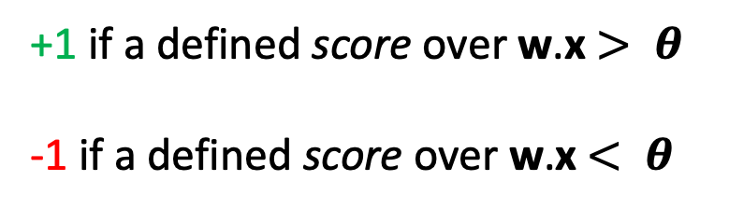
From Representation to Training
They then:
  trained a perceptron using the given training set, and once done,
  examined any new sequence and inferred whether it is a “true-site” or “non-site”
For this sake, they needed to associate a weight with each x_{ij} in any input feature matrix x (hence, they defined matrix w) and a threshold 𝜽 such that the (simplified) output is:
+1 if a defined score over w.x $> θ$
-1 if a defined score over w.x$< θ$
The special case where
the score is 𝜽 will be
regarded as “wrong”

Slide 6
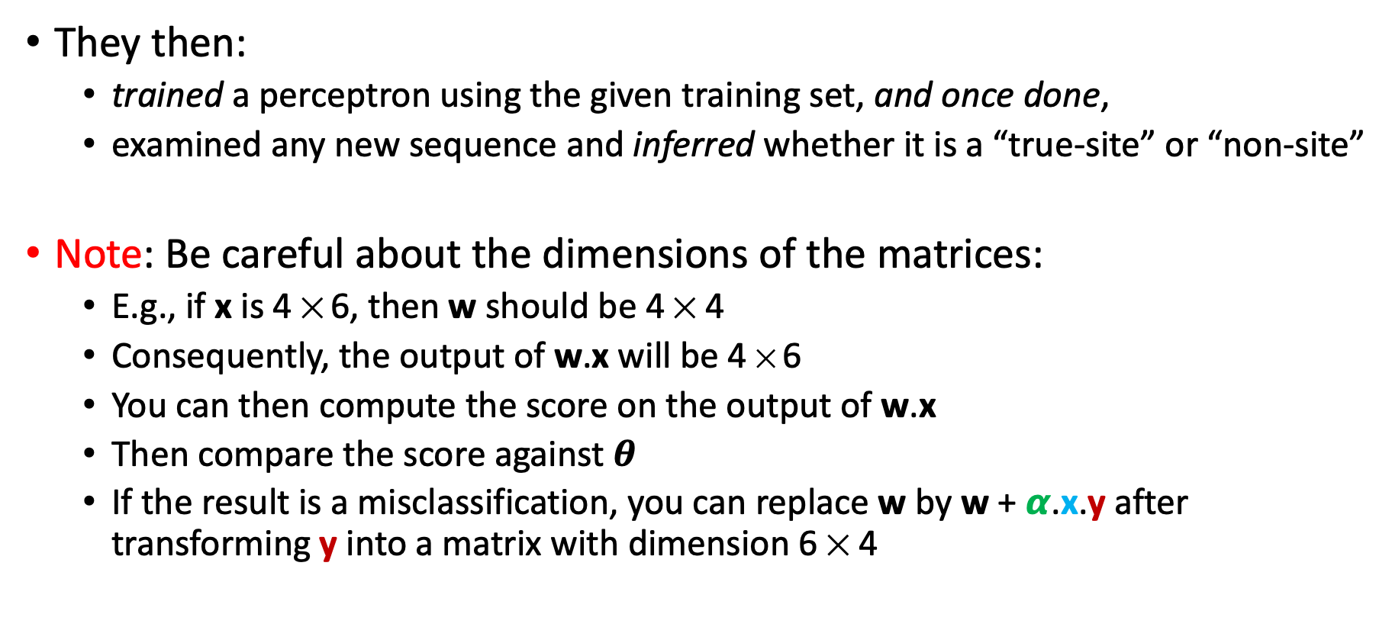
From Representation to Training
They then:
  trained a perceptron using the given training set, and once done,
  examined any new sequence and inferred whether it is a “true-site” or “non-site”
Note: Be careful about the dimensions of the matrices:
  E.g., if x is 4 ✕ 6, then w should be 4 ✕ 4
  Consequently, the output of w.x will be 4 ✕ 6
  You can then compute the score on the output of w.x
  Then compare the score against $θ$
  If the result is a misclassification, you can replace w by w + 𝞪.x.y after transforming y into a matrix with dimension 6 ✕ 4

Slide 7
Recall: Scores Over Position Weight Matrices
A score over a weighted matrix representation can be calculated as follows:
One column for each position in the Pribnow sequences
A | -38 | 19 | 1 | 12 | 10 | -48
C | -15 | -38 | -8 | -10 | -3 | -32
G | -13 | -48 | -6 | -7 | -10 | -48
T | 17 | -32 | 8 | -9 | -6 | 19
This matrix is the result of w.x
One row for
each nucleotide
Score of TATAAT = 17 + 19 + 8 + 12 + 10 + 19 = 85

Slide 8
Training
Perceptron algorithm:
  Assume 𝞱 is 0 and initialize the weight vector, w, to random numbers
  Pick a learning-rate, 𝞪, that is a small, positive real number
    Note: The choice of 𝞪 affects the convergence of the perceptron. If 𝞪 is too small, convergence is slow; if it is too big, the decision boundary will “dance around” and again will converge slowly, if at all
  Consider each training example t = (x, y) in turn:
    Let y′ = score(w.x)
    If y′ and y have the same sign, do nothing; t is properly classified
    if y′ and y have different signs, or y′ = 0, replace w by w + 𝞪.x.y. That is, adjust w slightly in the direction of x

Slide 9
Training
When to stop the perceptron algorithm?
  Ideally, you want it to stop when it converges (i.e., when it learnt enough and can now render quite accurate during inference)
  We can repeat step 3 in the perceptron algorithm and:
    Terminate after a fixed number of rounds
    Or, terminate when the number of misclassified training examples stops changing
    Or, withhold a test set from the training data, and after each round, run the perceptron on the test data. Afterwards, terminate the algorithm when the number of errors on the test set stops changing

Slide 10
From Training to Inference
In short, a matrix w can be learnt based on a given training set using a perceptron algorithm
Once learnt, w can be multiplied by any new sequence, x, represented as a matrix of 0s and 1s, after which we can infer whether x is a “true-site” or “non-site” based on the output score
  If the output score is greater than θ, the site is true
  If the output score is less than θ, the site is not true

Slide 11
Next Wednesday’s Lecture…
Perceptrons exhibit several limitations, which will be discussed next Wednesday
These limitations serve as a motivation for a better learning algorithm known as Support-Vector Machine (SVM), which we will discuss next Wednesday as well

Slide 12
References
[1] Rajaraman Anand and Jeffrey David Ullman. “Mining of massive datasets.” Cambridge University Press, 2011
[2] Stormo, Gary D. "DNA binding sites: representation and discovery." Bioinformatics 16.1 (2000): 16-23
[3] Stormo, Gary D., et al. "Use of the ‘Perceptron’ algorithm to distinguish translational initiation sites in E. coli." Nucleic acids research 10.9 (1982): 2997-3011
[4] de Smit, Maarten H., and J. Van Duin. "Secondary structure of the ribosome binding site determines translational efficiency: a quantitative analysis." Proceedings of the National Academy of Sciences 87.19 (1990): 7668-7672

